Slide 1
Unit 6 Word Problems
Two Unknowns with One Variable
Consecutive Numbers

Slide 2
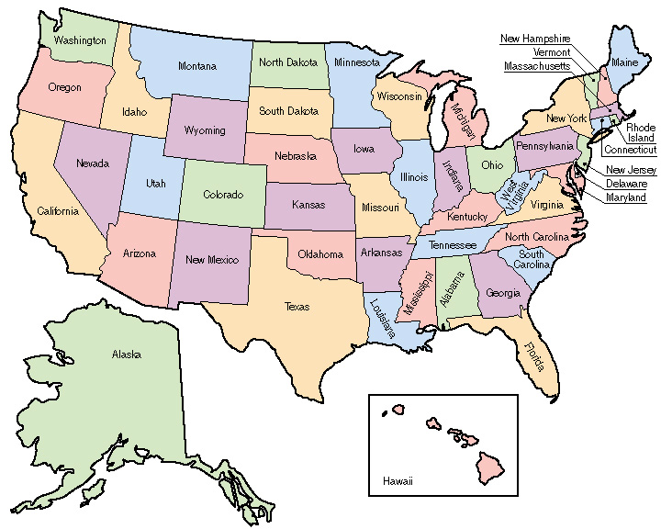
Let’s Learn the Method
Mr. Keohan has visited 2 more than 2 times as many states as Ms. Manning. The total visited was 47 states. How many states has each social studies teacher visited?

Slide 3
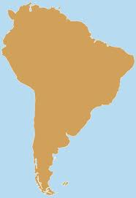
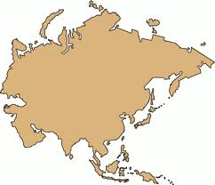
More Practice!
There are 60 countries in Asia and South America. Asia has 4 times as many countries as South America. How many countries does each area have?

Slide 4
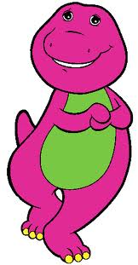
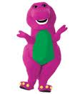
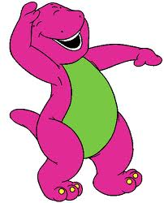
Let’s Try Another One
Barney plans to go the Island of Special Animals. There are lots of purple dinosaurs for him to meet and there are also orange dinosaurs which he looks forward to meeting. There are 561 total dinosaurs on the island and there are 6 less than 2 times the amount of purple animals as there are orange. How many of each type of dinosaur are there?

Slide 5
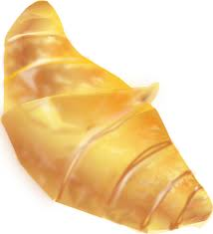
Here’s one for you to try
The cost of orange juice and a croissant is four times the price at Corner Café in Paris than it is at Regal Restaurant, in Atlanta. Hannah and Anna each ate at one of the restaurants with their families and spent a total of $40. How much did the croissant and juice cost at each restaurant?

Slide 6
Another one….
I always end up with extra luggage. On my last trip it cost $256 in extra baggage fees. I had three suitcases: the second one, which carried all my shoes and clogs, was twice the price of the first one, the third one was $28 less than the first one. How much were the fees for each suitcase?

Slide 7
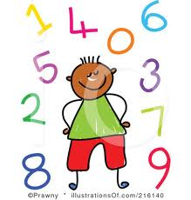
Consecutive Numbers: Same Idea
There are 2 consecutive numbers which equal 95. What are the 2 numbers?

Slide 8
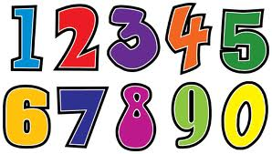
Consecutive Numbers: Try one!
There are 2 consecutive numbers which equal 129. What are they?

Slide 9
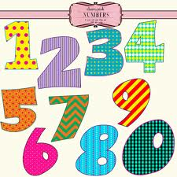
More
There are 3 consecutive numbers which total 867. What are the numbers?

