Slide 1
Population Samples

Slide 2
Definition
Biased event – when some people or things are more likely to be chosen than others.
Unbiased event – when some people or things are equally likely to be chosen. (random)

Slide 3
2) Tom asked all the students in his class if they could wiggle their ears. Is this sample of Tom’s class likely to be biased?
Example
Yes
No

Slide 4
The answer should have been no because every student was surveyed. It is likely to
be a unbiased sample.
Next Question

Slide 5
No, because every student was surveyed. This makes it an unbiased sample.
Next Question

Slide 6
A taste tester samples 3 cookies. The cookies are oatmeal, chocolate chip and raisin. If there are only 3 types of cookies available, is this sample of the cookies likely to be biased?
Yes
No

Slide 7
John asked the last 5 people that walked into class what their favorite dessert is. Is this sample of the students likely to be biased?
Example
Yes
No

Slide 8
A trainer surveyed all of the men at a local fitness gym about their favorite cardio exercise. Is this sample of the gym people likely to be biased?
Yes
No

Slide 9
Harper surveyed all the students on the high school basketball team on their favorite pre-game routine. Is this sample of the high school basketball students likely to be biased?
Yes
No

Slide 10
Jamie surveyed all the custodians on which classroom was the cleanest. Is this sample likely to be biased?
Yes
No

Slide 11
Ella asked every 20th customer who came into the mall about their favorite ice cream flavor. Is this sample of the customers likely to be biased?
Yes
No

Slide 12
Jeannie wants to determine the most popular car in her town. She goes to the largest local supermarket and asks the person entering the store at every half minute. Would this be an unbiased survey?
Yes
No

Slide 13
Example
18) The research below shows the number of parents that coached their children in certain sports. Of the 700
parents, how
many coached
their children in
baseball?
Parents coaching
Basketball
Football
10%
20%
Check your answer
Baseball
70%
70%

Slide 14
An educational book published the results of the most popular cities in America. Of the 75,000 surveyed, how
many chose
New York?
Check your answer
Popular US Cities
Orlando
New York
15%
60%
60%
Las Vegas
25%

Slide 15
1) Larry is taking sign-ups for the barbecue. Of the 50 people in high school that signed up for the barbecue, how
many of them
were juniors?
BBQ Sign-ups
Juniors
Sophomores
20%
30%
Seniors
15%
Check your answer
35%
Freshman

Slide 16
Key Points & Don’t Forget
1) Biased = not equally picked.
2) Not Biased = equally picked (random).
All Done!

Slide 17
Good work! The answer is no because he tried all 3 of the cookies, making his sample unbiased.
Next Question

Slide 18
The sample will be unbiased because he tried all 3 cookies. If he had not tried them all then it would be biased.
Next Question

Slide 19
Good work!! It is biased because it is not really a random sample of the class.
Next Question

Slide 20
You should have answered yes because this is not a random sample of the class and could then be biased.
Next Question

Slide 21
It will not be biased because his survey included all the students on the team.
Next Question

Slide 22
You are right!! It will be unbiased because he surveyed all the students.
Next Question

Slide 23
This survey would be biased because the women were not surveyed.
Next Question

Slide 24
Good!! For this to be unbiased the women must be surveyed too!!
Next Question

Slide 25
You should have answered no because he surveyed everyone on the staff and that would be a fair sample.
Next Question

Slide 26
You are right! He surveyed everyone so it would be a fair sample.
Next Question

Slide 27
Good work….this is a totally random way to conduct a survey.
Next Question

Slide 28
This would not be a biased survey because the sample is completely random.
Next Question

Slide 29
Great…This would be unbiased because she is surveying random people.
Next Question

Slide 30
Oops…this one would be unbiased because she is surveying random people entering the store.
Next Question

Slide 31
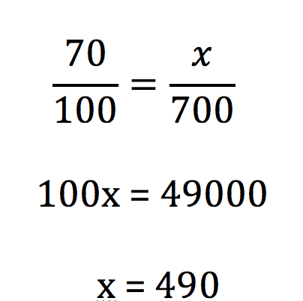
Next Question

Slide 32
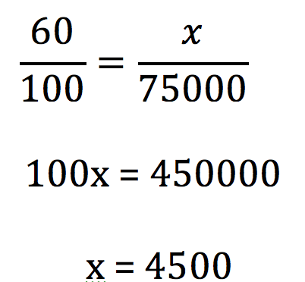
Next Question

Slide 33
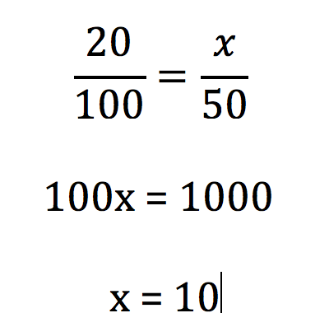
Next Question

